Slide 1
ORACLE DATABASE, JDK & JRE INSTALATION

Slide 2
AGENDA
JRE Installation
JDK Installation
Oracle Installation

Slide 3
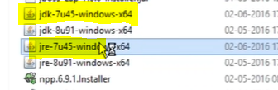
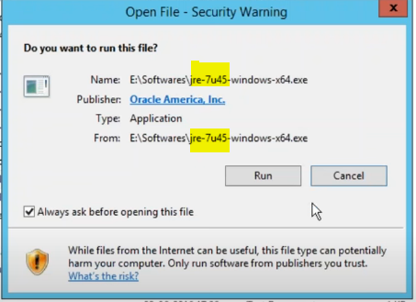
JRE INSTALATION
Download JRE from ORACLE site
Download the required version as per Infa MDM PAM sheet.

Slide 4
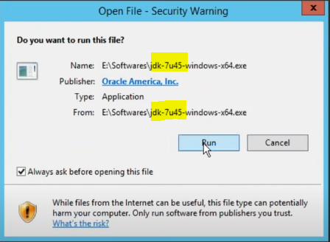
JDK INSTALATION
Download JDK from ORACLE site
Download the required version as per Infa MDM PAM sheet.

Slide 5
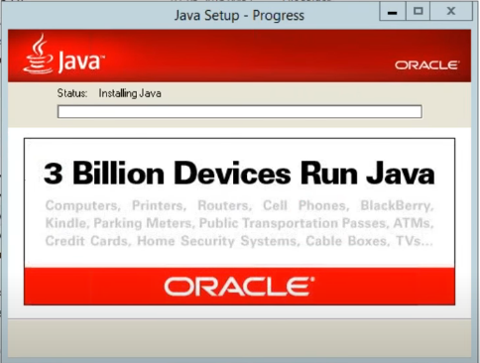
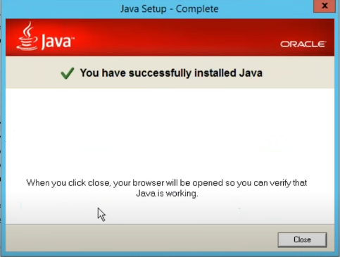
Installation Successful

Slide 6
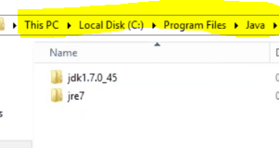
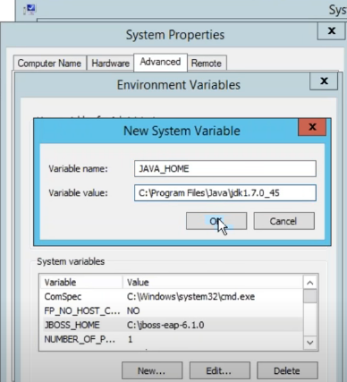
Verify Installation is Successful.
Set JAVA_HOME path

Slide 7
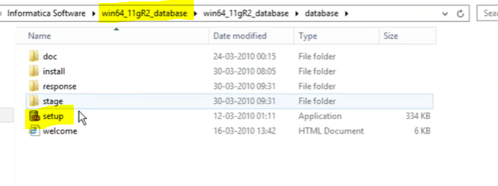
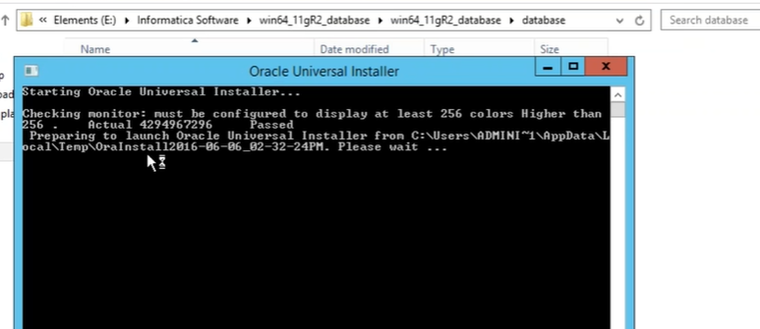
ORACLE DB INSTALATION
Download Oracle DB from ORACLE site.
Download the required version as per Infa MDM PAM sheet.
Go to DB Folder and run setup application

Slide 8
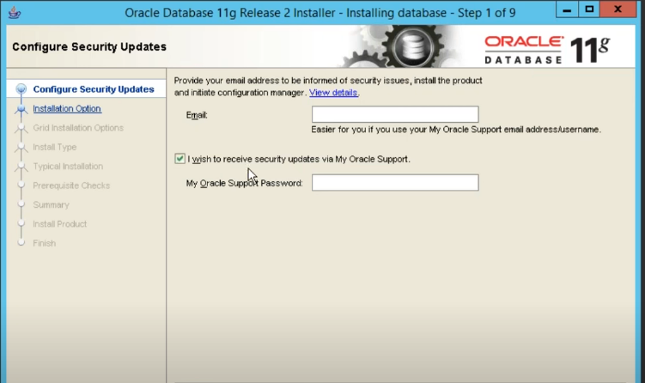
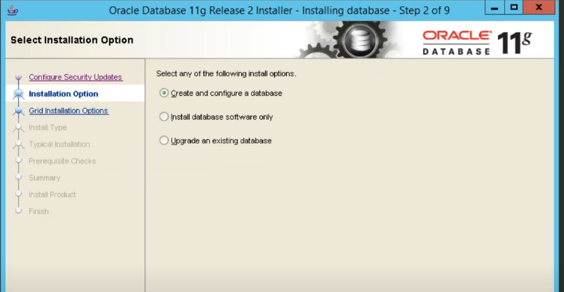
ORACLE DB INSTALATION
Select “Configuration Security Updates” as per requirement.
Click : Next >>
Select “Installation Option”

Slide 9
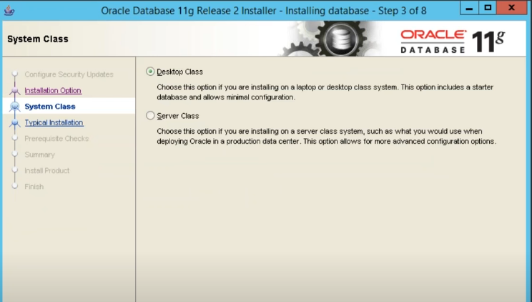
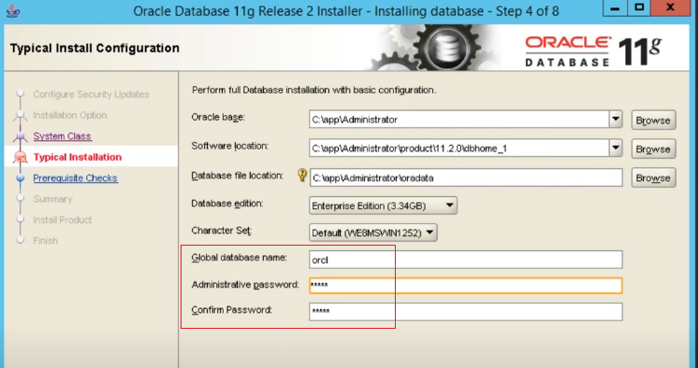
ORACLE DB INSTALATION
Select “System Class” as per requirement.
For PC installation → “Desktop Class”
For Server → “Server Class”
Click : Next >>
Select “Typical Installation”
Provide required information.

Slide 10
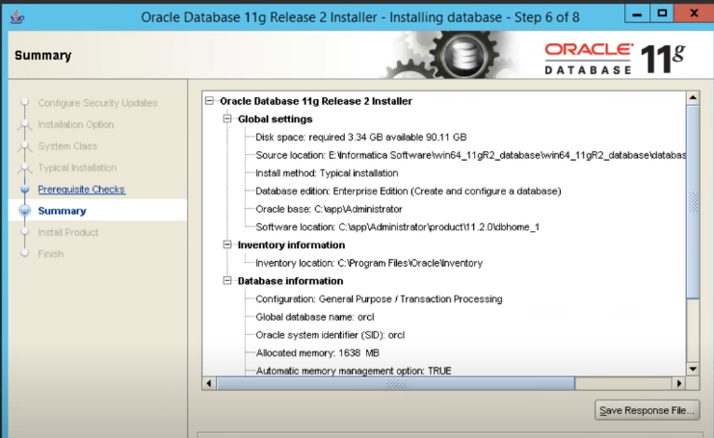
ORACLE DB INSTALATION
Check Summary
Click : Finish >>

Slide 11
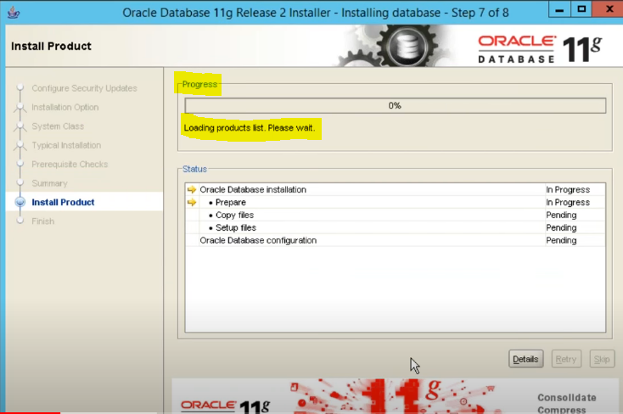
ORACLE DB INSTALATION
Installation will take 20-30 minute.

Slide 12
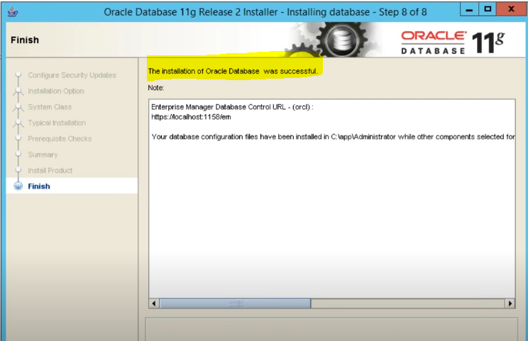
ORACLE DB INSTALATION
Installation Is Successful.

